Slide 1

Project Title -Seasonal Agriculture Performance Analysis
Student Name:-SUBRATA DAS
College Name-BRAINWARE UNIVERSITY
AICTE STU ID :- STU6a29897a346d41781107066

Slide 2

PROBLEM STATEMENT
(Agricultural activities are influenced by seasonal variations in environmental conditions, farming practices, resource availability and market conditions. As a result, agricultural performance may differ from one season to another. However, raw agricultural data does not clearly explain how agricultural performance changes across seasons or what patterns can be observed in different seasonal conditions. The problem is to analyze the given agricultural dataset and investigate seasonal differences in agricultural performance by identifying meaningful patterns, trends, relationships and variations within the available data.

Slide 3
Seasonal Agriculture Performance Analysis is a data analysis project that studies agricultural performance across different seasons, crops, and regions. The project analyzes factors such as rainfall, temperature, soil conditions, fertilizer, pesticide usage, water consumption, yield, production, revenue, and profit. Data visualization and statistical analysis are used to identify seasonal patterns, compare agricultural performance, and understand the relationship between environmental conditions and crop outcomes. The findings can help in making better decisions related to crop planning, resource usage, and agricultural productivity.

Slide 4

WHO ARE THE END USERS?
Farmers – To understand seasonal crop performance and improve farming decisions.
Agricultural Planners – To compare seasonal trends and plan agricultural activities.
Agricultural Researchers – To study relationships between environmental factors and crop performance.
Government & Agricultural Departments – To support better agricultural planning and resource management.
Agricultural Businesses – To understand production, market, revenue, and profit patterns.

Slide 5

Technology Used
Python – Main programming language
Pandas – Data cleaning and analysis
NumPy – Numerical operations
Matplotlib – Data visualization
Seaborn – Statistical graphs and visualizations
Jupyter Notebook / Google Colab – Project development and analysis

Slide 6
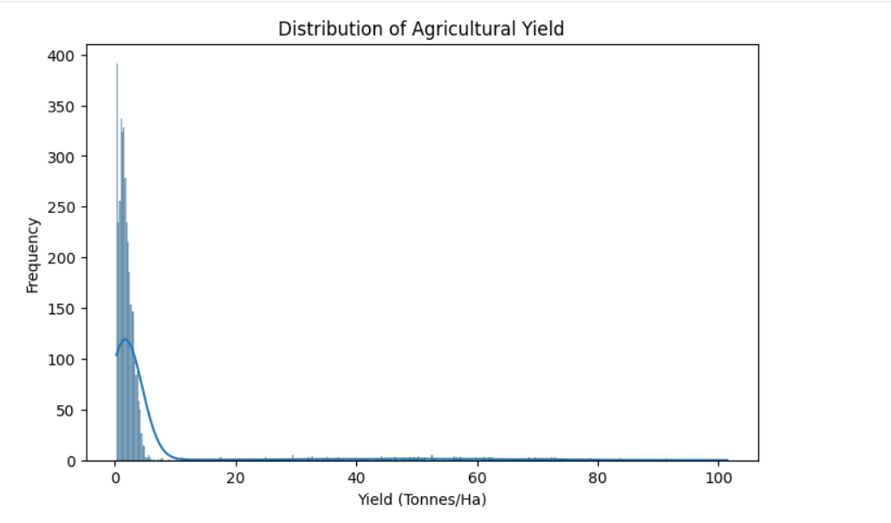
RESULTS
This graph shows how the agricultural yield is distributed in the dataset. Most farms have a low yield, mainly concentrated between 0 and 5 tonnes per hectare. As the yield increases, the number of farms decreases sharply. There are also a few farms with very high yields, reaching around 100 tonnes/ha, which appear as unusual values or outliers.

Slide 7
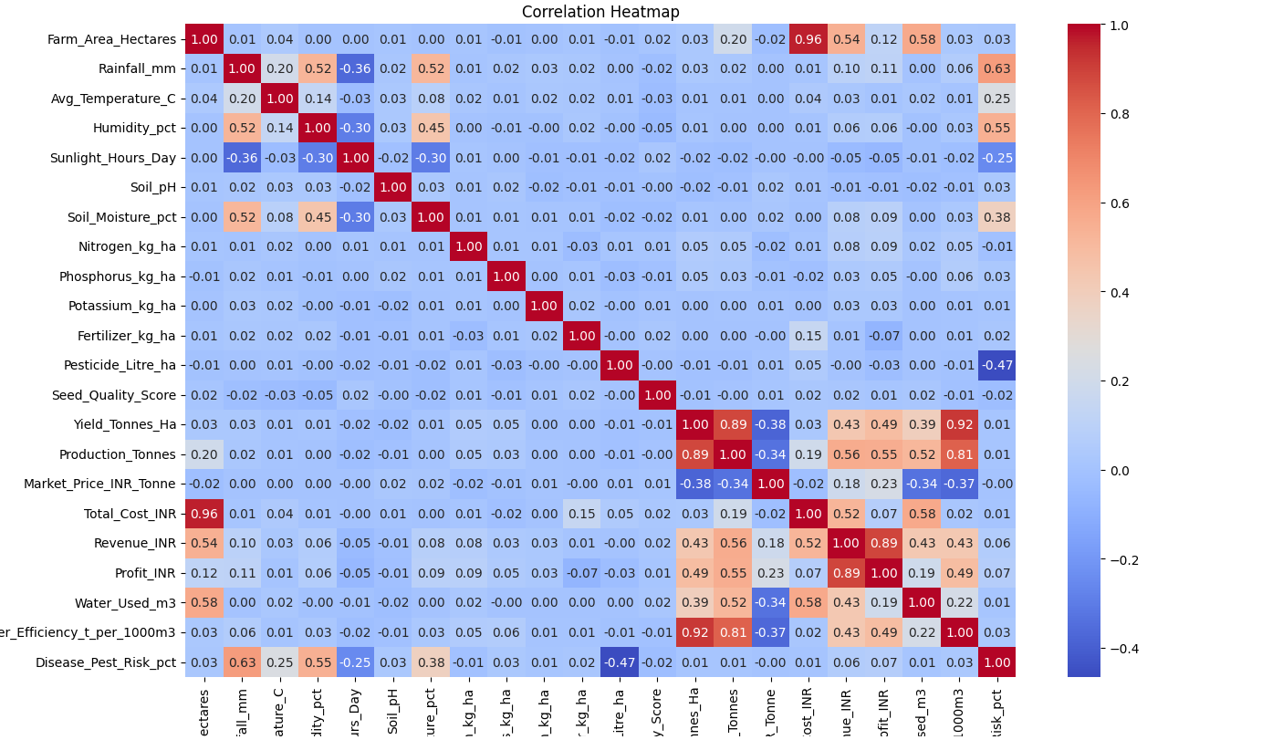
RESULTS
The heatmap helps us understand which factors have a strong or weak connection with agricultural performance.

Slide 8
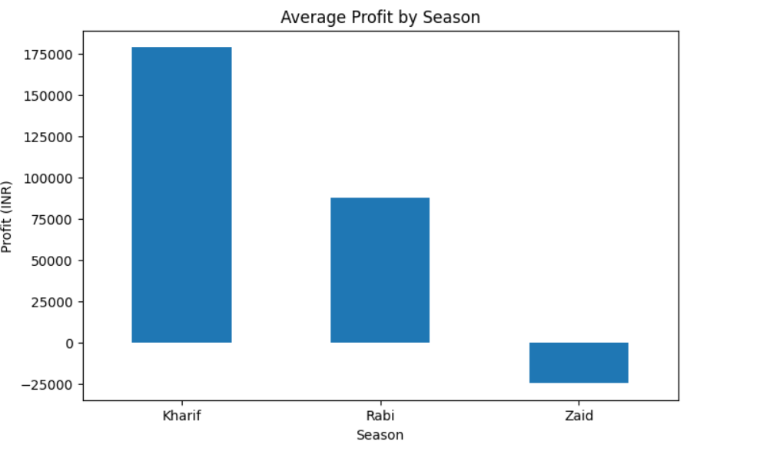
RESULTS
The graph shows that Kharif season has the highest average profit, followed by Rabi season. Zaid season has a negative average profit, meaning farmers generally face a loss during this season.

Slide 9
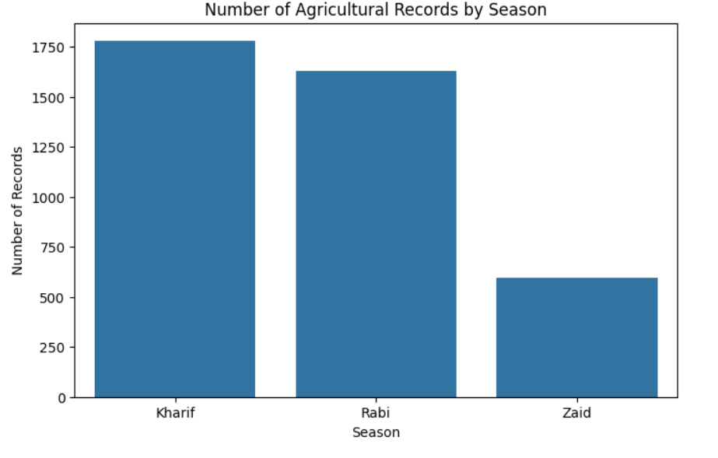
RESULTS
The graph shows that Kharif has the highest number of agricultural records, followed by Rabi. Zaid has the fewest records compared to the other two seasons.

Slide 10
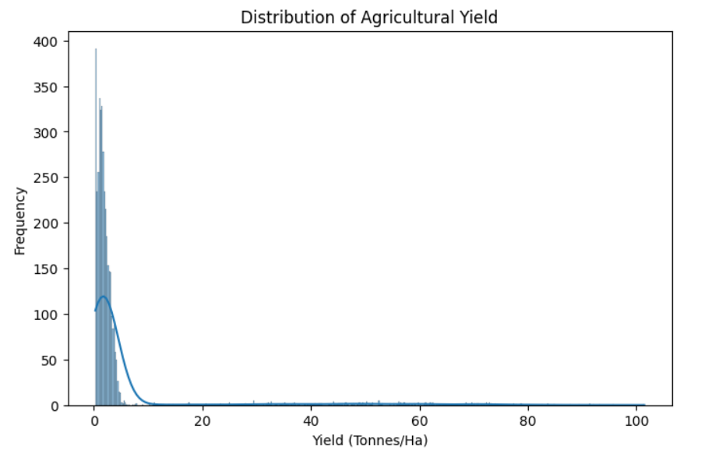
RESULTS
The graph shows that most agricultural yields are low, mainly between 0 and 5 tonnes per hectare. As the yield increases, the number of records decreases, with only a few records showing very high yields.

Slide 11
Future scope
Add real-time agricultural data for better analysis.
Use machine learning to predict crop yield and profit.
Develop crop recommendation based on seasonal conditions.
Add weather forecasting for better farming decisions.
Include more regions, crops, and seasons for wider analysis.
Develop an interactive dashboard for farmers and agricultural planners.

Slide 12
GitHub Link
https://github.com/subrata131/Seasonal-Agriculture-Performance-Analysis

Slide 13

VOIS Course completion certificate - Course name- Data Visualization

Slide 14
Thank you
.
.

